Slide 1
Using K-means and Foursquare Info to advice venue.

Slide 2
Main goal Advice one venue for new user.

Slide 3
Methodology
Collect users and venues information
Cluster users based on personal information
Select Best Venue for each cluster
Classifier new user for one cluster
Advice for new user the venue based on cluster.

Slide 4
User and Venue information
Use API and Pandas to aggregate User and venues information.

Slide 5
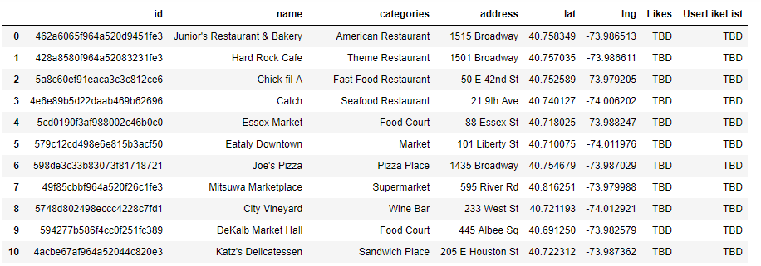
User and Venue information
Venue information

Slide 6
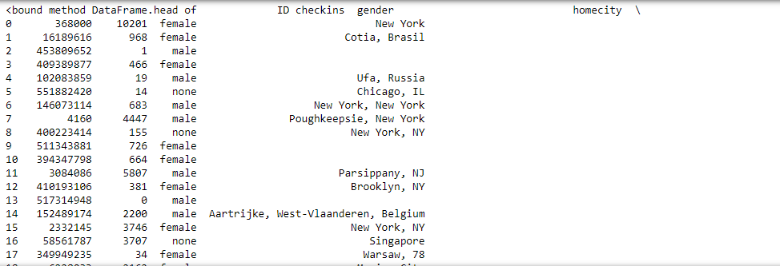
User and Venue information
User Information

Slide 7
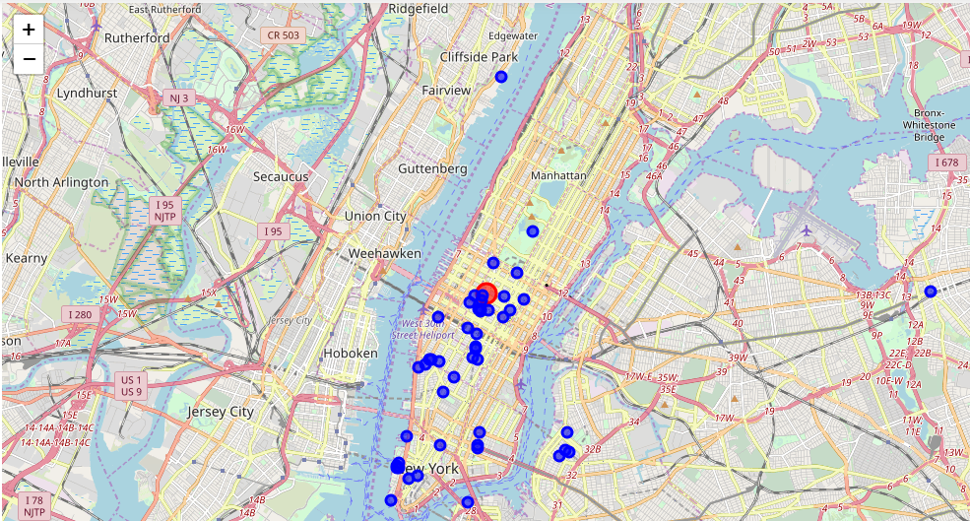
User and Venue information
Venue information - Position

Slide 8
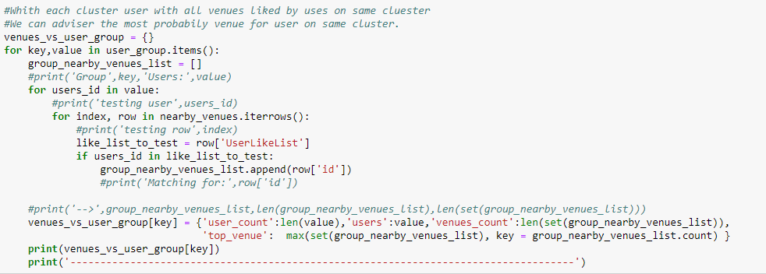
Cluster venue information
Sum of users likes for each group.

Slide 9
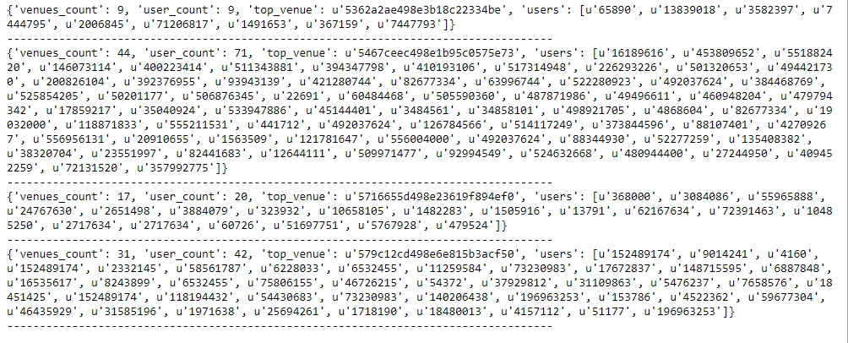
Clusters have one best Venue
New Uses are classified on one cluster, and receive best venue of this cluster.

